Slide 1
Using Metabolic Modeling to Answer Biological Questions
A Portable System for the Analysis of Metabolic Models

Slide 2
Outline
Download our Materials
Introduction to Modeling
E. coli Core metabolic model
Installing PSAMM
Working with the Core Model
Performing Experiments in PSAMM

Slide 3
Downloading the Resources we Need
First we will clone a git repository with all of the files we need to run our analyses
git clone https://github.com/keitht547/PSAMM-Demo.git
Then cd PSAMM-Demo
Or download zip file from https://github.com/keitht547/PSAMM-Demo
Then run
unzip <filename>
cd <filename>

Slide 4
What we have
We have the E. coli core metabolic model
We have version 0.18 of PSAMM
We have this PowerPoint
Some additional information about the core model

Slide 5
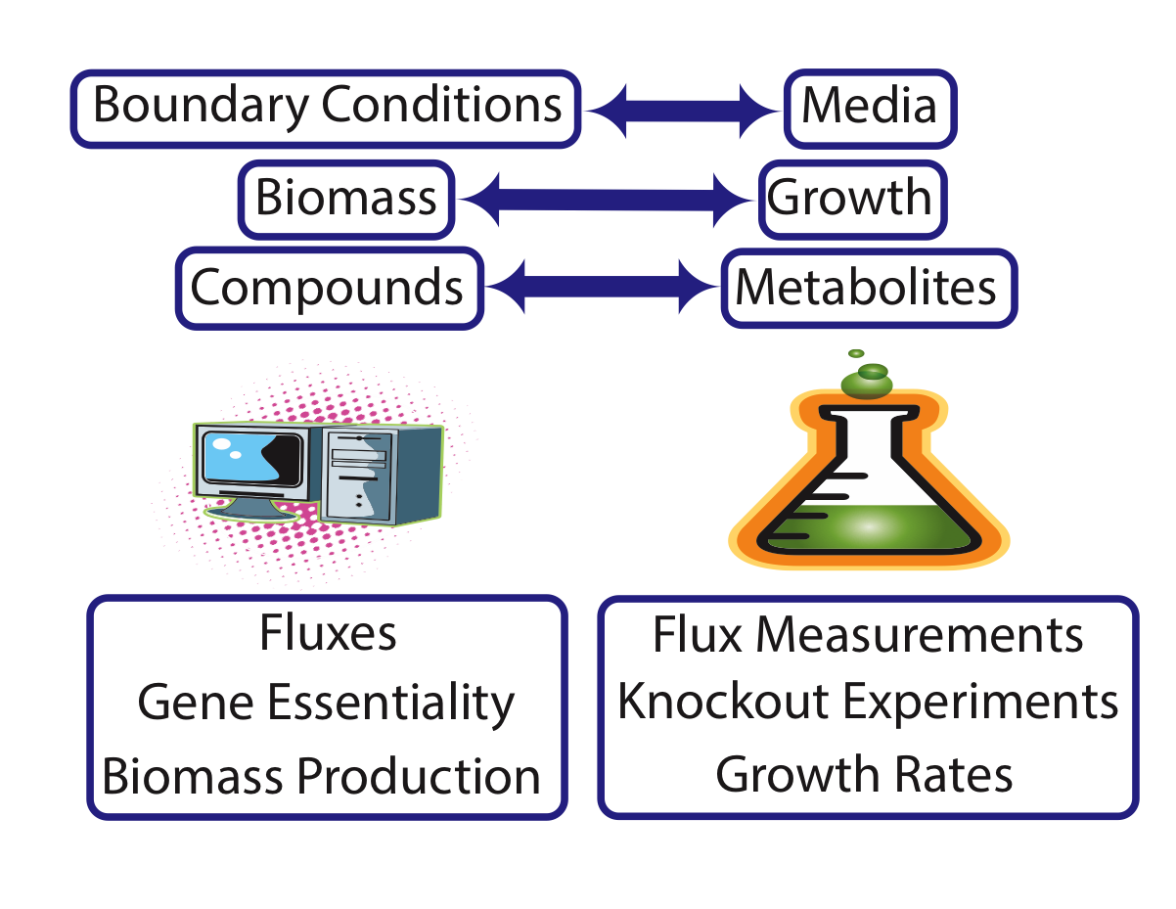
Laptop v Benchtop

Slide 6
GPR Associations

Slide 7
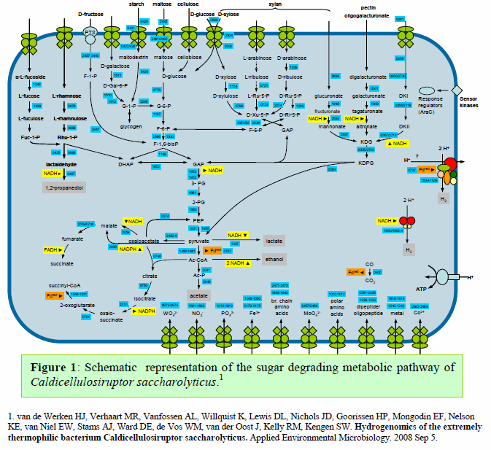

Slide 8
Biomass Function

Slide 9
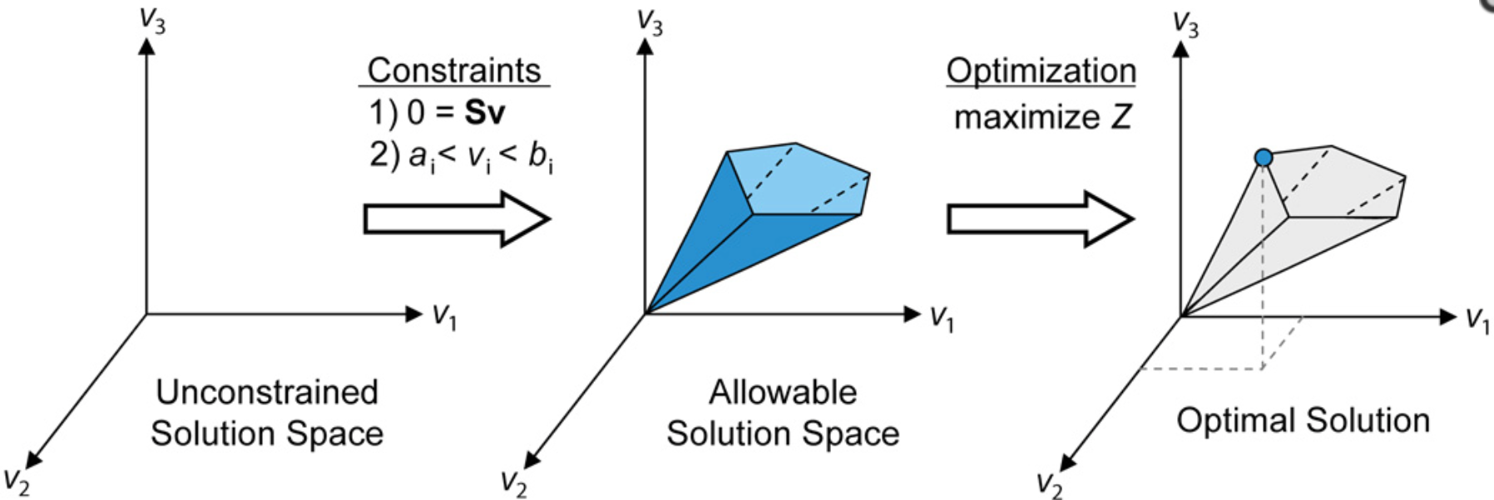
Simulating Growth in a Model
Linear Programming
Each reaction acts as a constraint on the overall model
Additional limits act as constraints
These constraints in total form a solution space of possible reaction fluxes
Find the solution that maximizes the flux through the objective function.
Orth et al 2010

Slide 10
E. coli Core Metabolic Model
Orth et al. 2010
Published as an educational and debugging tool
http://www.asmscience.org/content/journal/ecosalplus/10.1128/ecosalplus.10.2.1#backarticlefulltext
137 Genes
95 Reactions
72 Metabolites

Slide 11
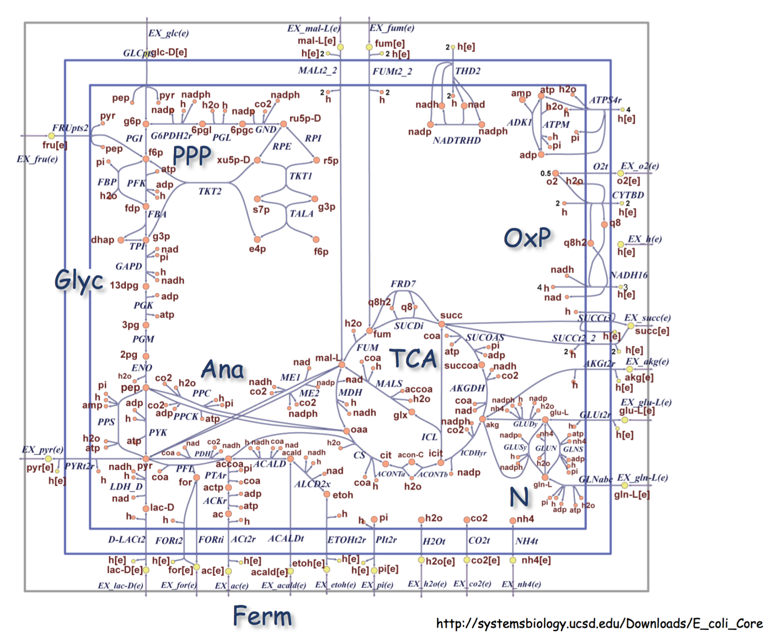

Slide 12
Biological Questions
At what level of glucose is growth optimal?
How does fermentation compare to respiration?
Are there alternative utilization pathways in the model?
What is the minimal subset of this model that can still function?

Slide 13
Downloading PSAMM
Go into the tutorial files
cd PSAMM-demo
Make a virtual environment
/opt/local/bin/virtualenv-2.7 env
Activate the environment
source env/bin/activate
then unzip the psamm program
unzip psamm-v.18.zip

Slide 14
Installing an LP solver and PSAMM 0.18
Install CPLEX
pip install ~/Applications/IBM/ILOG/CPLEX_Studio126/cplex/python/x86-64_osx/
Install PSAMM
pip install psamm-80237bf243b952261c635a7d15574a6657f95c57/
Check that everything is working
psamm-model -h

Slide 15
A Portable System for the Analysis of Metabolic Models
All functions in PSAMM are run through the psamm-model command
Look at the available function
psamm-model –h
This will list out all of the functions that are available in PSAMM

Slide 16
YAML Model Format
Go into the core model folder
cd e-coli-core
Lets look at the files individually
less <file_name>

Slide 17
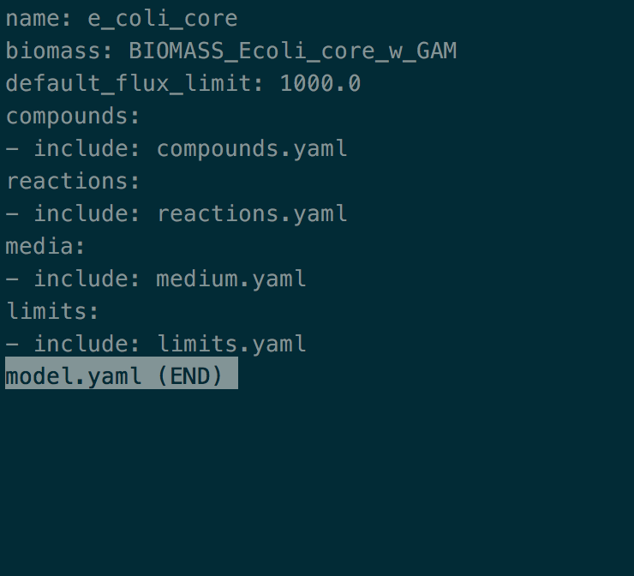
Model File
Generally called model.yaml
Contains paths to other model components and default settings

Slide 18
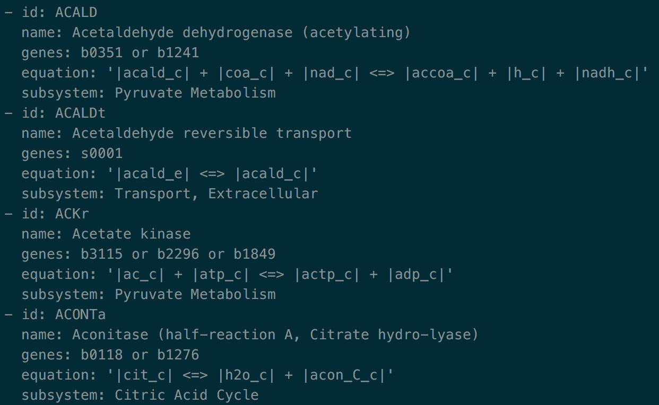
Reactions File
Contains the reaction information
IDs
Genes
Reaction formulas
Names
Anything else you want

Slide 19
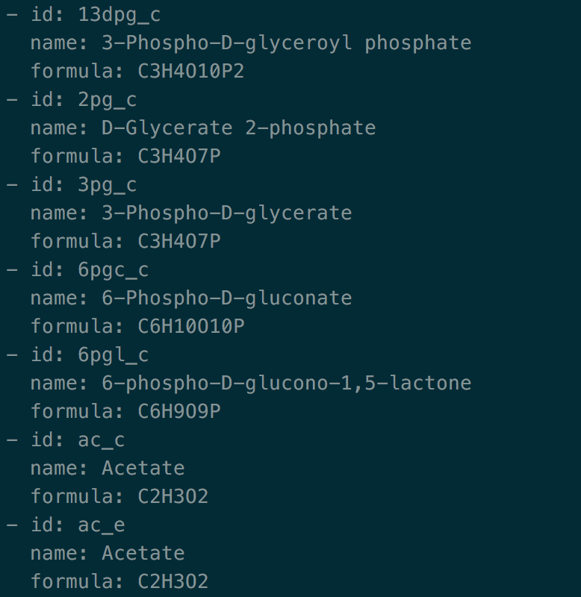
Compounds File
Compound information for metabolites in model
Compound ID
Compound name
Compound formulae
Charges
Anything else

Slide 20
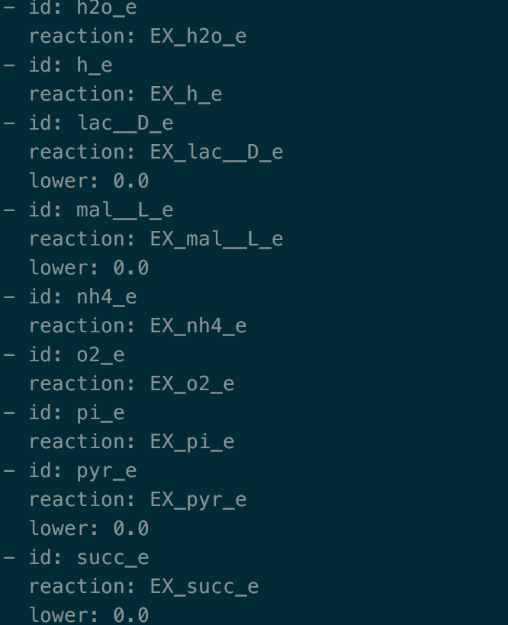
Limits file
File to add additional flux constraints to a model
Reaction ID
Lower bound
Upper bound

Slide 21
Lets Do Some Computational Biology
What do we get
A series of fluxes for each reaction in the network and an overall biomass flux
Run FBA on the model
psamm-model fba
Orth et al. 2010

Slide 22
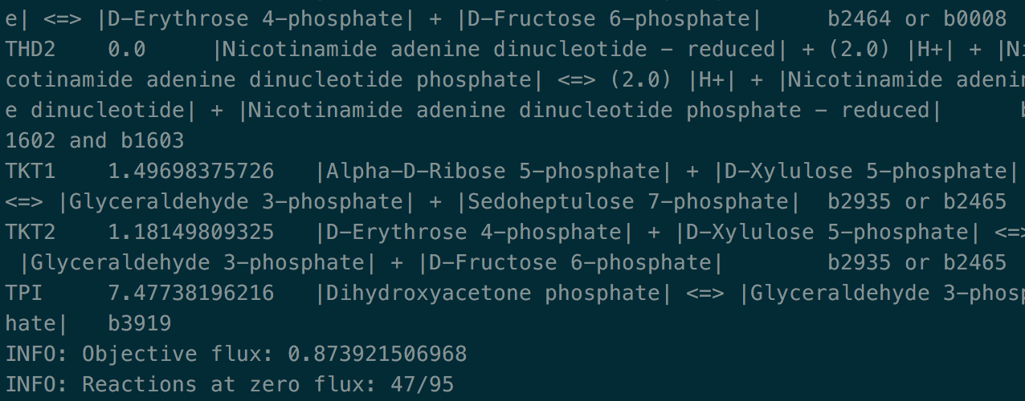
FBA Results

Slide 23
Lets check out Fermentation versus Respiration
Run a simulation under respiratory conditions
psamm-model fba --all-reactions>resp.tsv
Now we are going to remove oxygen from the boundary conditions.
nano media.yaml
Change lower bound of O2 reaction to 0
Save file
psamm-model fba --all-reactions>ferm.tsv
diff resp.tsv ferm.tsv

Slide 24
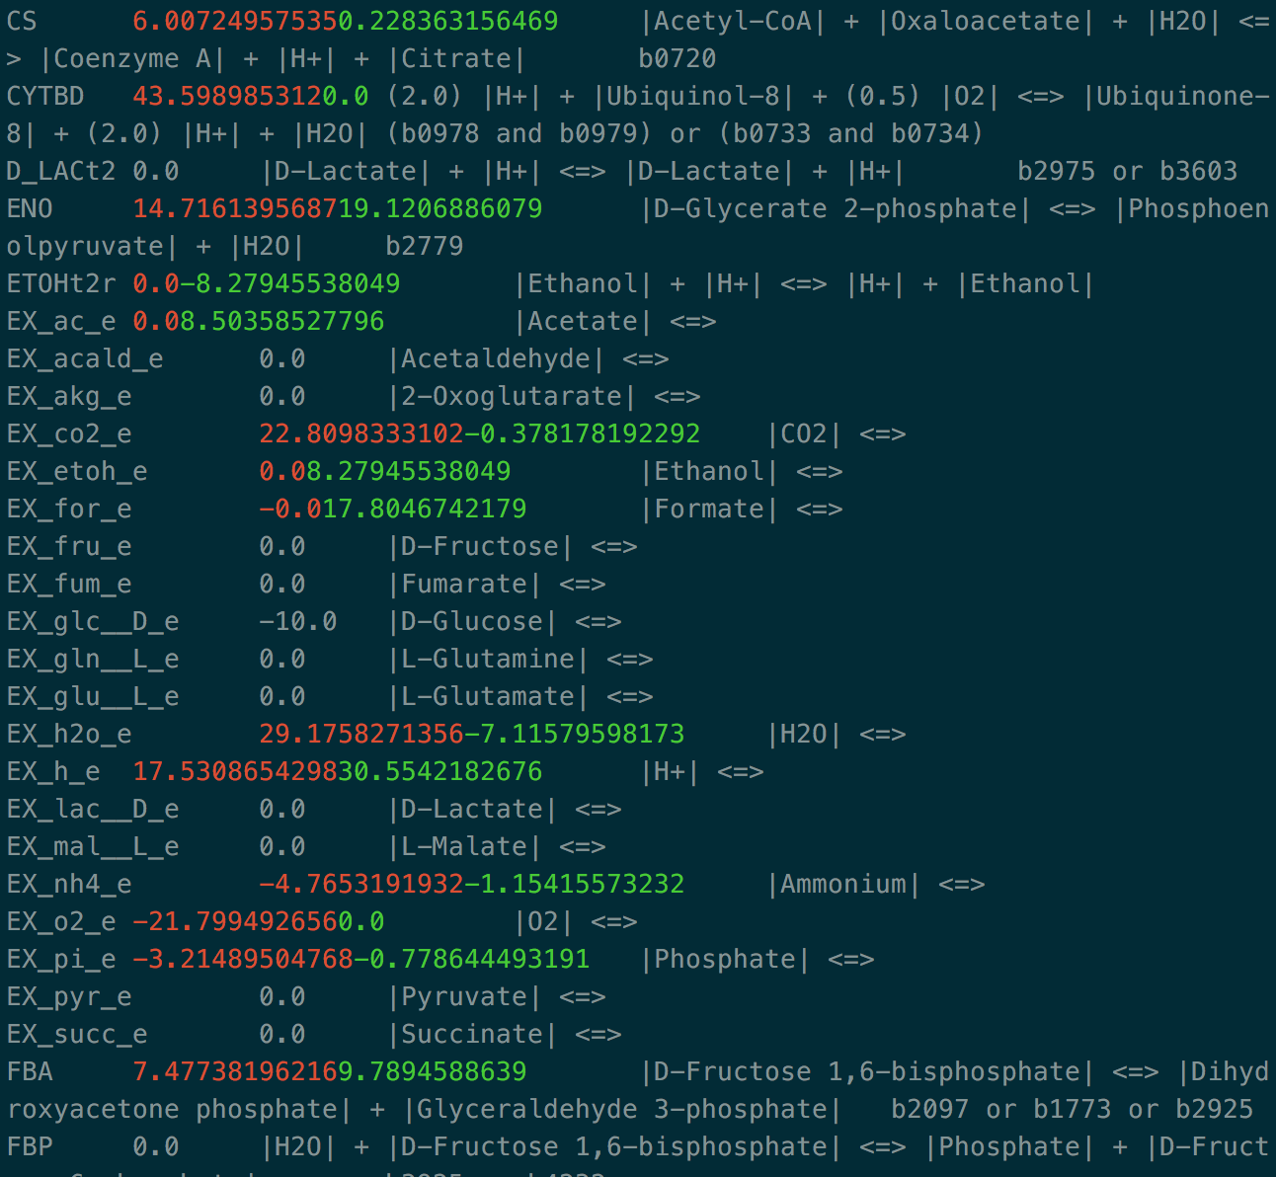
What reactions are different what are the same?

Slide 25
Consumption and Production
Metabolic networks take in metabolites from the boundary conditions and in some cases can produce metabolites as well.
We can look at these in the EX_* reactions.
Run fba again and this time lets look at the boundary reactions
psamm-model fba|grep EX

Slide 26
Fermentation Byproducts
What is being produced by the model?
Why?
Find the reaction that is producing these compounds in the model.

Slide 27
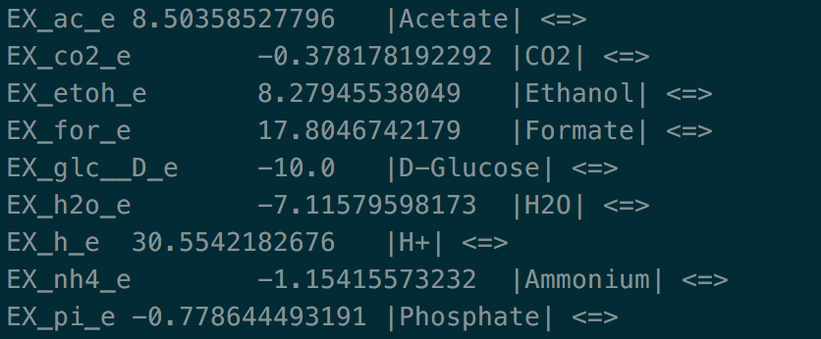
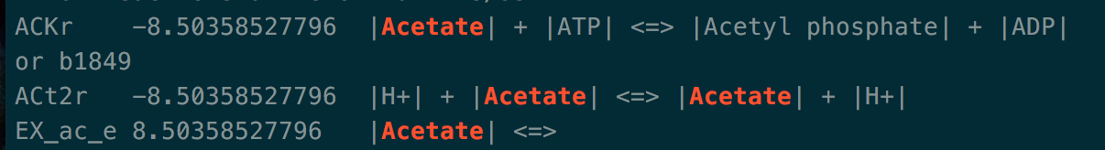
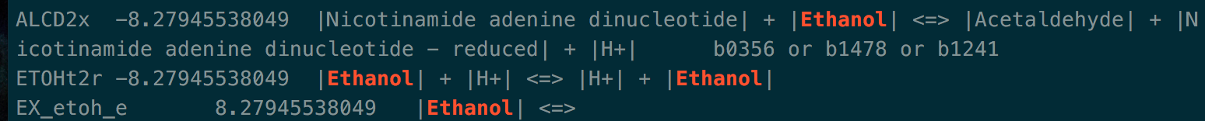

Slide 28
Alternative Pathways
We can use Flux Variability Analysis to analyze alternative pathways in a model
Add Objective Flux as a Constraint
Maximize and Minimize Each Reaction
FBA

Slide 29
Running FVA
cpd1
cpd2
cpd3
cpd4
cpd5
Run FVA on the Model
psamm-model fva

Slide 30
Another way to check if other pathways can be used
Fluxcheck
Models are not perfect and sometimes there can be reactions that are blocked in the network and cannot carry flux
Can also be used to check for what pathways can be used in a condition.

Slide 31
Fluxchecking
Run fluxcheck on the model
psamm-model fluxcheck
What do we see. What kinds of reactions are blocked?
Checking the overall network
psamm-model fluxcheck --unrestricted

Slide 32
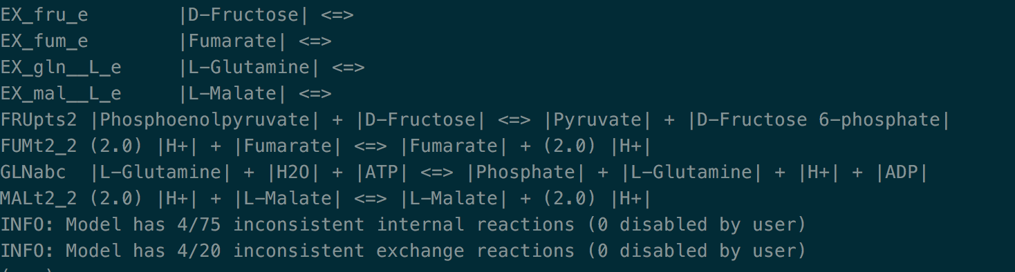

Slide 33
Finding a Minimal Reaction Network
Most models include more than just core metabolic functions.
How can we tell what is essential in the model?
We could systematically delete reactions one at a time and see when the model stops functioning.
Or we can use the randomsparse function in PSAMM.

Slide 34
Randomsparse
Finding minimal reaction networks
psamm-model randomsparse --type reactions 75%
We can also do this for the genes in the network
psamm-model randomsparse --type genes 75%

Slide 35
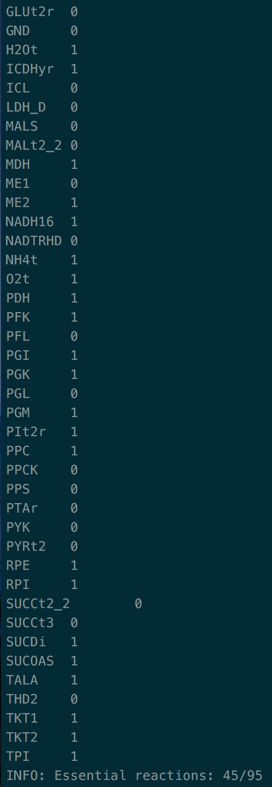
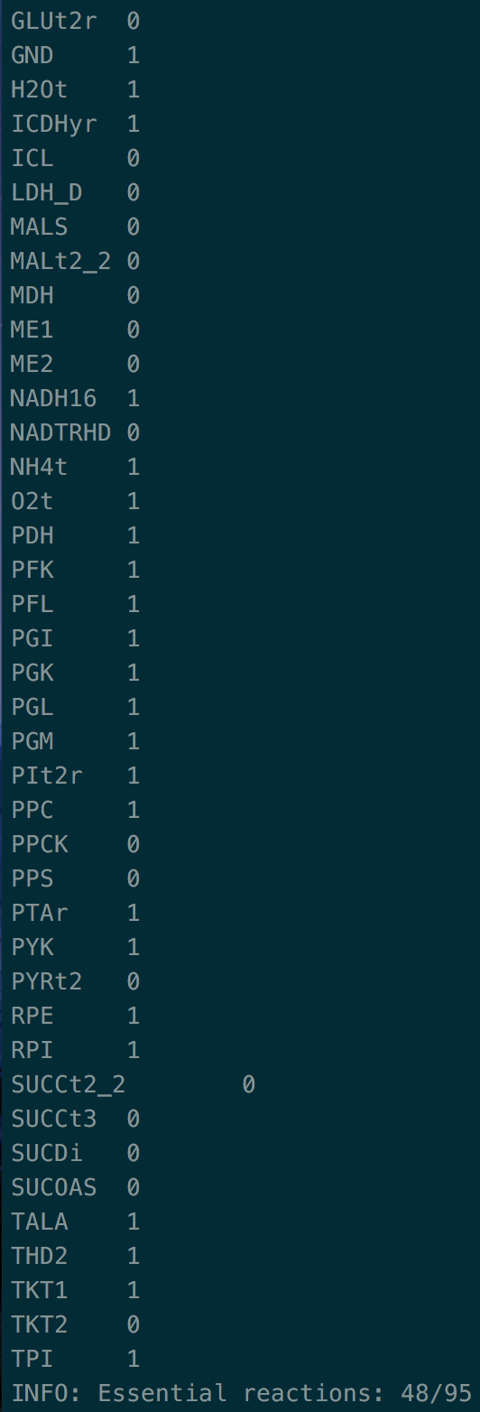
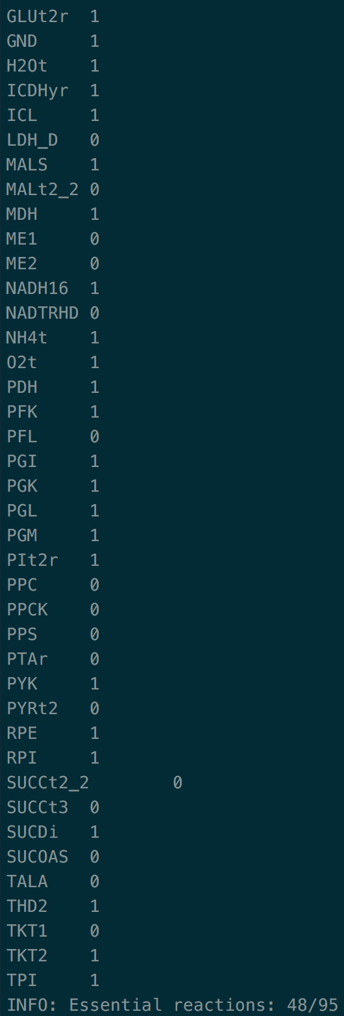
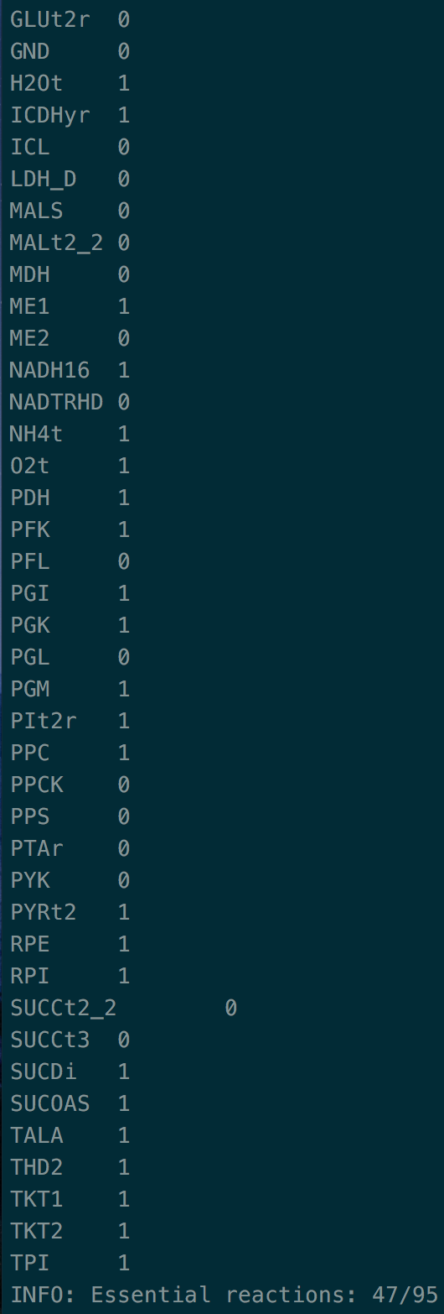

Slide 36
Other functions in PSAMM
Formulacheck and chargecheck
Checking the reaction formulas for consistency in terms of number of each atom in the reactions or for the charges on the reactions
psamm-model formulacheck
psamm-model chargecheck

Slide 37
Other PSAMM Functions
Masscheck
Checks for stoichiometric consistency in the model
psamm-model masscheck --type reactions
psamm-model masscheck --type compounds

Slide 38
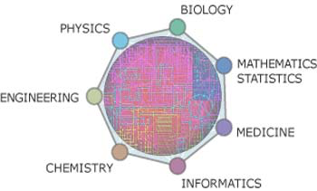
Future of Modeling in Biology
Metabolic Engineering
Modeling uncultivable organisms
Predictive modeling
Drug targeting
Modeling Bacterial communities
Modeling more complex eukaryotes
http://www.eie.gr/nhrf/institutes/ibrb/programmes/metabolicengineering-en.html

Slide 39
Thanks Ya’ll
Questions, Comments, Concerns?

